Slide 1
SASD Maximo Ecosystem Upgrade
Initiative – 166
11/02/2022 Status Meeting

Slide 2
Agenda
1
Last 47 days
2
For the remainder of 2022
3
Mitigated Risks
4
Open Risk and Possible Blockers
5
Schedule
6
Q&A

Slide 3
The last 47 days:
Completed Spatial and Widget Development!!
Migrated Spatial and Widget to TEST!!
Maximo in PROD is 90% complete
Maximo Sandbox is 50% complete
UAT is 85% complete. Effort was delayed by Starboard. Only minor defects were found.
GIS PROD environment is 10% complete
Physical TEST SQL Cluster is 95% complete. ETA is 11/04/22

Slide 4
The last 47 days (continued)
County 311 Integration development is complete and has been validated in DEV.
County 311 Integration migrated to TEST and is in UAT
Physical PROD SQL Cluster is 50% complete
Started to develop cut over plan
Started documenting the difference between current production and the new version of Maximo
UAT Team has started to develop the training plan. Currently engaged with Training Dept.

Slide 5
For the rest of 2022
Prep and migrate over to the physical TEST SQL cluster
100% validate TEST environment on physical hardware.
Prep for load test #2 – full system (must pass)
Setup and Configure PROD physical SQL cluster
Migrate PROD environment to physical SQL cluster
Start smoke test PROD on physical SQL cluster
Fine tune cut over plan

Slide 6
Risks mitigated since last status meeting
# | Description | Status
7 | Physical SQL server hardware is still back-ordered | Hardware arrived unexpectedly on 9/22/2022, a month earlier than any ETA given.
17 | Cost for Maven support will increase if we do not complete this project by end of 2022 | Confirmed with Maven that the increase will $5.00 per hour. Contract language allows for a 5% increase as long as total $ amount is within original contract.
22 | Weather App data source in current production will be end of life before we can move to production with the new Maximo. | New API has been implemented in the current production. There will not be an interruption in service.
24 | Project resources being idle | Hardware came in a month before we anticipated so there will not be a lull in work.

Slide 7
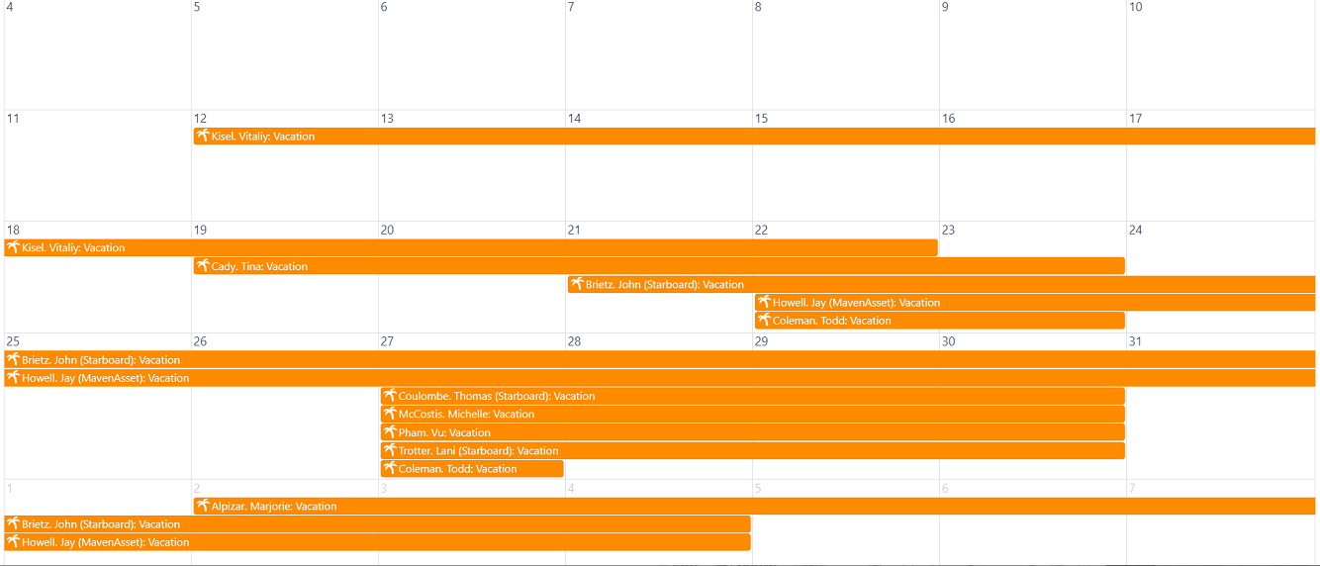
Initiative-166 Open Risks and Possible Blockers
# | Description | Status
18 | Not enough support hours included in the contracts to complete the project. | Continuing to monitor this resource
23 | Due to delays with moving to PROD, we may run into the need to apply security patches to Maximo. | This would require additional work to validate the patch in DEV and TEST. Depending on the patch, we may have to do some UAT again.
Multiple members of Don Keene system testers might be out due to Covid-19

Slide 8
Schedule
Milestone | Completion Target Date | Status
Migrate TEST environment to TEST Physical SQL Cluster | 11/18/2022
Validate TEST environment on TEST Physical Cluster is 100% the way we want it. Smoke Test and repeat some UAT as needed Prep for Load Test #2 Continue to build out PROD on VM SQL Cluster | 1/6/2022
Load Test #2 on Physical TEST SQL Cluster – This is a showstopper if we do not pass. | 01/11/2023
Migrate from PROD to Physical PROD SQL Cluster | 01/20/2023
Smoke Test entire system in PROD and Prep for Dress Rehearsal | 01/27/2023
Dress Rehearsal of Cut Over | 01/30/2023 to 02/02/2023
Training of field crews and any system/functionality changes that will impact the user base | 02/06/2023 to 02/17/2023
Go Live Cut Over Weekend (if we have a GO from the business) | 02/23/2023 to 02/27/2023
30 day warranty post implementation support/clean up work | 02/27/2023 to 04/01/2023

Slide 9
SASD Projects and Efforts on Hold
Business Planning
Underground Facility Claims module in Maximo
Information Management
ArcGIS Field Maps for Insect Mitigation implementation and development
ArcGIS Pro integration
CMMS Evaluation
Enterprise/Portal final implementation
Hiring GIS Analyst I/II
Migration from ArcPad to StudioGo final implementation
Pipeline Support
Granite upgrade
Evaluation of the Max_report list (currently 1,400 reports)
Several Change Advisory Committee (CAT) items implementation related to new tools to improve work efficiency and additional functionality in Maximo, impacting SASD across the board

